Slide 1
Research Communication Skills
Reading papers and creating an overview

Slide 2
Objectives:
  Build a categorized understanding of related works and synthesize that knowledge into a larger framework.
  Be able to identify relationships between papers in your chosen topic area.
  Be able to categorize and synthesize information from different papers.
  Be able to write a structured and well-organized survey paper.

Slide 3
Example

Slide 4
Warm up (10 minutes)

Slide 5
Warm up – part 1
Focus on the related work description of the paper submitted to the group
You can find relevant information in the introduction and related work sections
Underline sentences where the following information is described:
  A brief description of the paper’s relation to other works
  Take note of how the authors categorize previous studies and what themes or areas they emphasize.
  “What categories or classifications did you find in the related work sections? How can they inform your own survey?”
Output
  A list of identified categories or research areas

Slide 6
LASEC: A Localized Approach to Service Composition in Pervasive Computing Environments
This paper proposes a localized approach to service composition in pervasive computing environments
The related work section is organized from broadly related to most related

Slide 7
LASEC: A Localized Approach to Service Composition in Pervasive Computing Environments
Service composition in different kinds of environments
Approaches to composition in pervasive computing environments
Motivate the need for localized solutions

Slide 8
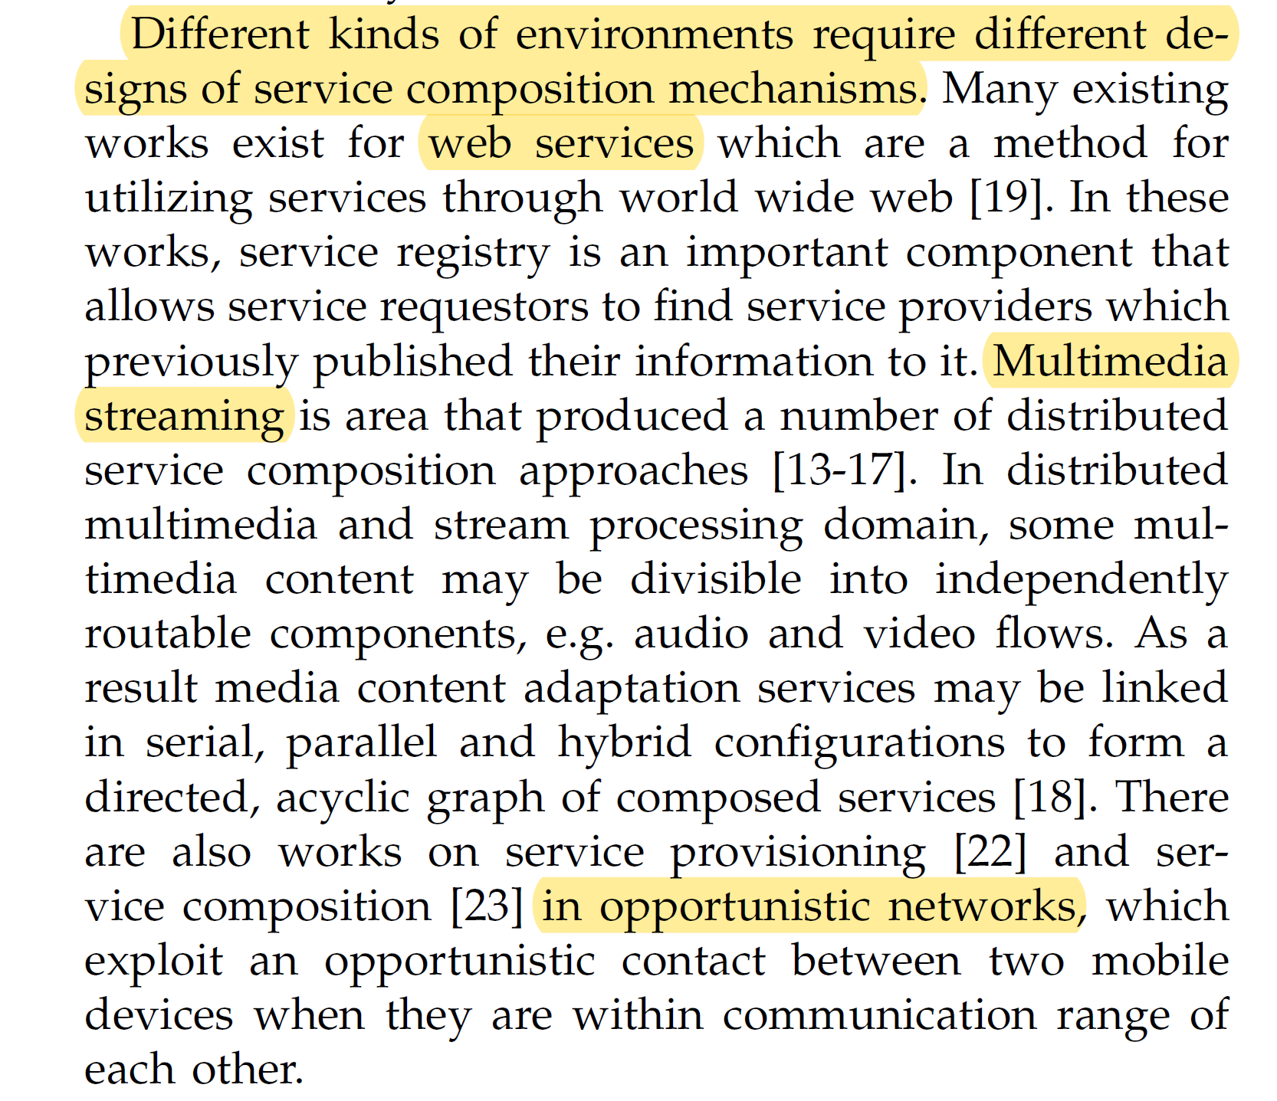

Slide 9
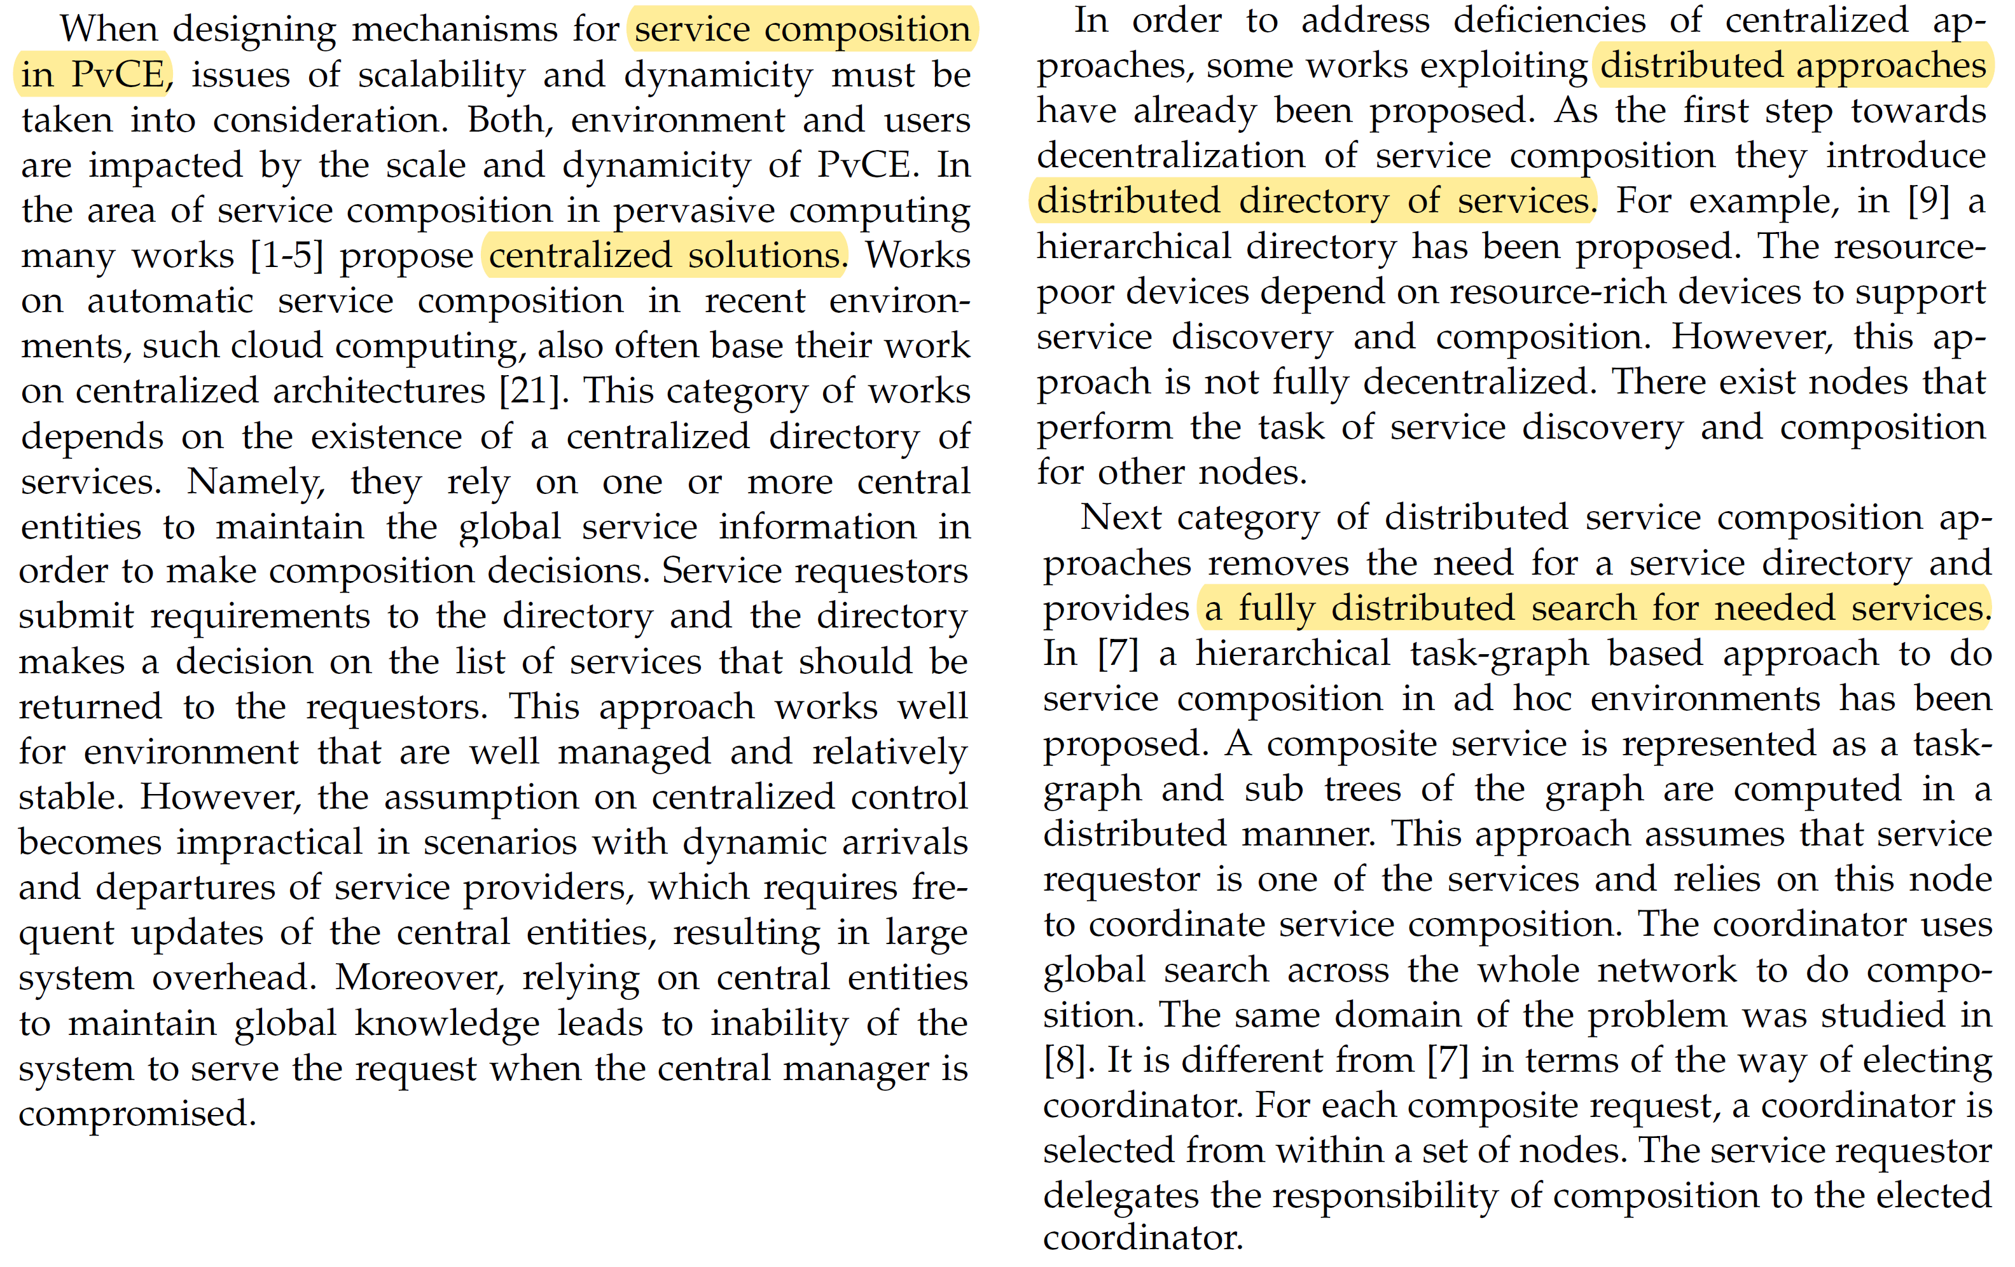

Slide 11
Taking notes
  A list of identified categories or research areas
  Critically evaluate the strengths and limitations of each related work / groups of works

Slide 12
Warm up – part 2
Extract and categorize the related work/introduction section into a tree structure, showing the relationships between the works cited.
Focus on identifying high-level themes, subcategories, and the relationships between them (e.g., chronological progression, methodologies, subdomains, …)

Slide 13
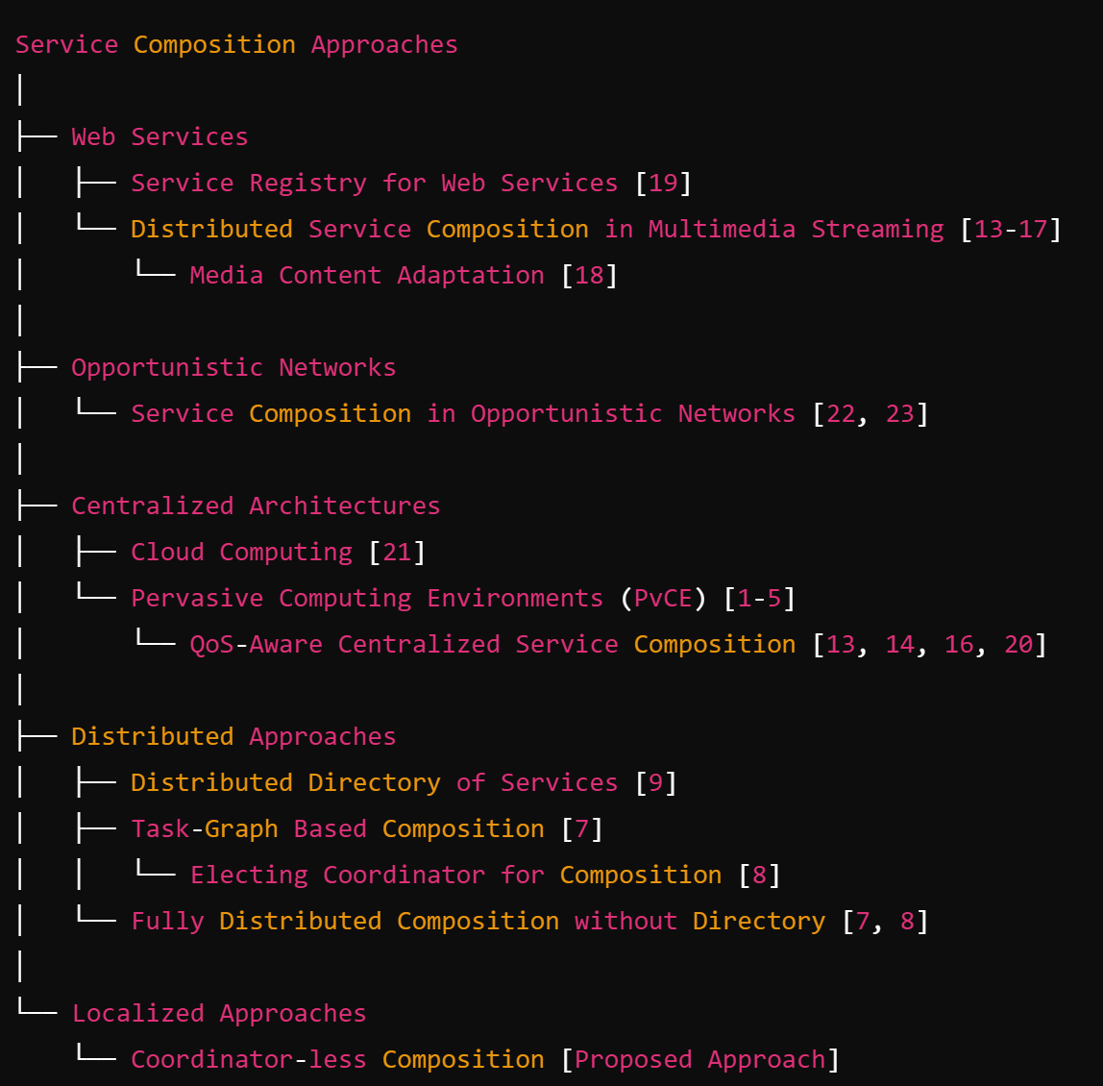
Tree example

Slide 14
Please prepare your materials
Topic/survey title of your group
Important papers related to your topic

Slide 15
Please put your name and your group’s topic on the top of the worksheet and return it to me by the end of the class to get participation points

Slide 16
Warm up (10 minutes)
Focus on the related work description of 2-3 of your papers
  You can find relevant information in the introduction and related work sections
For each paper, underline sentences where the following information is described:
  A brief description of the paper’s relation to other works
  Take note of how the authors categorize previous studies and what themes or areas they emphasize.
  “What categories or classifications did you find in the related work sections? How can they inform your own survey?”
Output
  A list of identified categories or research areas

Slide 17
Task 1 (30 minutes)
Choose a research paper from your set
  Extract and categorize the related work/introduction section into a tree structure, showing the relationships between the works cited.
  Focus on identifying high-level themes, subcategories, and the relationships between them (e.g., chronological progression, methodologies, subdomains, …)
Pick other papers and build more trees

Slide 18
Some questions you might ask yourself when reading papers and categorizing them
which one of the 3-4 big research directions they tell?
what approaches/mathematical techniques /algorithms etc they rely on?
is this a theory or application paper?
is it the continuation of another work? is it an improvement on another work?
do they use theoretical proofs? simulation? hardware testbed? Real life deployment?
which other technology they compare themselves with? In which way are they better? Note: all the papers you will encounter are at least in some ways better than others. You need to identify the authors claim; higher performance (under certain assumptions)? higher robustness? lower computational complexity?
…

Slide 19
 | Example 1 | Example 2
Step 1: Identify Key Themes from the related work section | different algorithm families | monetary policy models, fiscal policy approaches, or trade theories.
Step 2: Place Major Branches in the tree corresponding to these themes | supervised learning, unsupervised learning | Keynesian Economics, Monetarism, and Supply-Side Economics.
Step 3: Add Sub-Branches for more specific topics | specific types of neural networks | Under Keynesian Economics, sub-branches could include short-term economic stabilization, government intervention in recessions, or public investment in infrastructure.
Step 4: Link Papers to Each Sub-Branch based on their focus | papers on convolutional neural networks would go under that sub-branch | Papers that discuss government spending during recessions would fall under the sub-branch of government intervention in recessions, while papers that focus on public investment's long-term effects would fit under public investment in infrastructure.

Slide 20
Task 2 (for the students who finished task 1 early)
Look for similarities, differences, and potential overlaps between the trees.
  Could certain categories from one tree fit into another tree?

Slide 21
Break time (5 minutes)
Please sit together with your group after the break

Slide 22
Group Discussion (15 minutes)
Compare the trees your group members built for their papers.
  Look for similarities, differences, and potential overlaps between the trees.
    “Why do you think these categories overlap?”
    “What makes these two works fundamentally different?”
  Discuss whether certain categories from one tree could fit into another tree and why.

Slide 23
Group Task (30 minutes)
In the groups, work together to merge your individual trees into one larger, combined tree.
  You may need to rename categories, merge branches, or create new branches that represent overarching concepts or themes.
  Provide clear labelling of categories and subcategories.
Output:
  A big tree that synthesizes the literature from multiple papers.

Slide 24
Expansion 1
Continually refine and expand your categorization as you collect more papers
  “How would this paper fit into my tree?”
  “Is there any useful information in the introduction/related work section” of this paper that will help me improve my categorization?

Slide 25
Expansion 2
Check your notes where you evaluated the strengths and limitations of each related work / groups of works
Map this information to your tree

Slide 26
Conclusion
The key skills you have learned
  Categorization
  Merging ideas
  Synthesis
How this exercise will directly inform your survey paper writing
  Structuring your paper
  Organizing related works into themes
  Synthesizing ideas from multiple sources
Next Steps
  Continue this process with your collected papers, expanding and refining your category trees as you gather more literature

Slide 27
Homework 4

